Slide 1

Retrieval Augmented Generation (RAG)
Workshop
January 2025
Jason Haley
Independent Consultant
@haleyjason

Slide 2
Questions for you
Do you know what Retrieval Augmented Generation (RAG) is?
Have you used a RAG application yet?
BTW: ChatGPT does a good job with RAG these days
How about built one?
How many people have used Azure SQL?

Slide 3
Phases of LLM Usage
General use and awareness
01
Combining LLM with external data and APIs
02
Agents or multi-step workflows with LLMs and other sources
03
Tools or systems that provide actual business value
04

Slide 4
Using LLMs in Applications
Chatbot – Simple back and forth messaging between system and user
RAG – Chat with your own data ←This is what we will explore
Copilot – Assistants that work with you to complete tasks
Agents – Minimal human intervention to follow instructions and perform tasks autonomously
Other ways LLMs are used:
Data generation, summarization, classification, writing drafts, and many more!

Slide 5
Retrieval Augmented Generation Pattern
3 Steps
Do a search in your retrieval system
Augment the prompt with search results
Pass to LLM

Slide 6
Use Cases for RAG
Customer support and help desks
Legal Document Analysis
Healthcare Information Systems
Education and e-Learning
Enterprise Knowledge Management
Research Assistance
Content Generation
Many more …
Notes:
Retrieval Augmented Generation (RAG) is a powerful approach that combines the strengths of retrieval-based systems with generative AI to provide contextually relevant, accurate, and comprehensive responses. Here are some use cases where RAG shines:
1. Customer Support and Help Desks
Provide accurate and context-aware responses to user queries by retrieving relevant knowledge base articles, FAQs, or documentation.
Handle dynamic queries where static FAQs might not suffice, using the most up-to-date data.
2. Legal Document Analysis
Summarize or extract insights from legal documents by combining retrieval from legal databases with generative explanations.
Help legal professionals with case law research or contract analysis.
3. Healthcare Information Systems
Retrieve and summarize medical literature, research papers, or patient data to assist healthcare providers in decision-making.
Support patient queries with precise and contextually relevant information.
4. Education and e-Learning
Enhance e-learning platforms by generating answers or explanations based on course materials or academic databases.
Assist students with context-aware study aids that incorporate textbook and online resources.
5. Code Assistance and Documentation
Provide coding help by retrieving relevant sections from documentation, code repositories, or Q&A platforms like Stack Overflow.
Auto-generate code snippets or explain functions using the retrieved information.
6. Enterprise Knowledge Management
Enable employees to access specific policies, procedures, or organizational knowledge quickly by combining retrieval with tailored responses.
Support onboarding and training by answering questions using company documents or manuals.
7. Financial and Market Analysis
Provide investors or analysts with up-to-date summaries from market reports, financial news, and research papers.
Generate tailored financial advice or insights by combining historical data with recent trends.
8. Scientific Research Assistance
Help researchers by retrieving and synthesizing information from scientific papers, journals, and datasets.
Facilitate hypothesis generation by integrating diverse data points.
9. Product Recommendations
Enhance e-commerce platforms by retrieving relevant product information and generating personalized recommendations.
Tailor responses to user preferences by incorporating product reviews and specifications.
10. Compliance and Audit
Assist organizations in staying compliant by retrieving relevant regulations and generating compliance summaries.
Automate audit preparations by consolidating and presenting necessary documentation.
11. Media and Content Generation
Help journalists or content creators by retrieving background information or previous articles to support new stories.
Generate summaries or insights based on retrieved data.
12. Multilingual Support
Bridge language barriers by retrieving documents in one language and providing synthesized translations or summaries in another.
Key Strengths of RAG:
Dynamic Knowledge Updates: Easily adapts to changes in the knowledge base, ensuring responses are up-to-date.
Context-Aware: Tailors answers based on the query context, improving relevance.
Scalability: Works effectively with vast, unstructured data sources, scaling well across industries.
These use cases illustrate how RAG combines structured retrieval with the creativity and flexibility of generative AI to address complex, real-world problems.

Slide 7





RAG Application System Flow
Answer
Retrieval System
User query
Augmented Prompt
System Prompt
User Prompt
OpenAI
Data sources
Ingestion System
Context

Slide 8
Retrieval System
Pre-step of searching your data sources before calling LLM
Goal is to provide knowledge for LLM to use

Slide 9
Searching Types
Keyword
Semantic or Similarity
Hybrid (with reranking)

Slide 10
Lab 3: RAG With Web Search

Slide 11

Ingestion/Indexing System
Data quality is directly related to how useful your system will be
Are you starting with structured or unstructured data?
Structured – content is already in a database (relational, document db, graph db)
Unstructured – data is not organized, such as documents
How will the data be updated? How often?
What metadata will be helpful in searching?

Slide 12
Embeddings
Represent semantically similar items
Types
Vectors (arrays) of numbers
Common distance metrics
Cosine Similarity
Euclidean Distance
Dot Product
Word embeddings
Sentence or document embeddings
Image embeddings
Audio and video embeddings
Knowledge graph embeddings
Hugging Face Leaderboard: https://huggingface.co/spaces/mteb/leaderboard
Notes:
https://huggingface.co/spaces/mteb/leaderboard

Slide 13

Vector Databases
Azure SQL (public preview)
Azure AI Search
Cosmos DB
Pinecone
Chroma
Qdrant
Many others…

Slide 14
Chunking and Its Challenges
Process of breaking something up into smaller parts (ie. files or text)
Keep mind: Embeddings encode a meaning for a given chunk of text
What does that mean for blocks of text?
Character count
Overlap (10 – 20 %)
Paragraphs
Pages
Other
What about tables of text?
What about images or charts?
Notes:
5 Levels Of Text Splitting
https://github.com/FullStackRetrieval-com/RetrievalTutorials/blob/main/tutorials/LevelsOfTextSplitting/5_Levels_Of_Text_Splitting.ipynb
Chunking - Optimizing Vector Database Data Preparation
https://research.trychroma.com/evaluating-chunking
The BEST Way to Chunk Text for RAG
https://www.youtube.com/watch?v=Pk2BeaGbcTE&t=2s

Slide 15
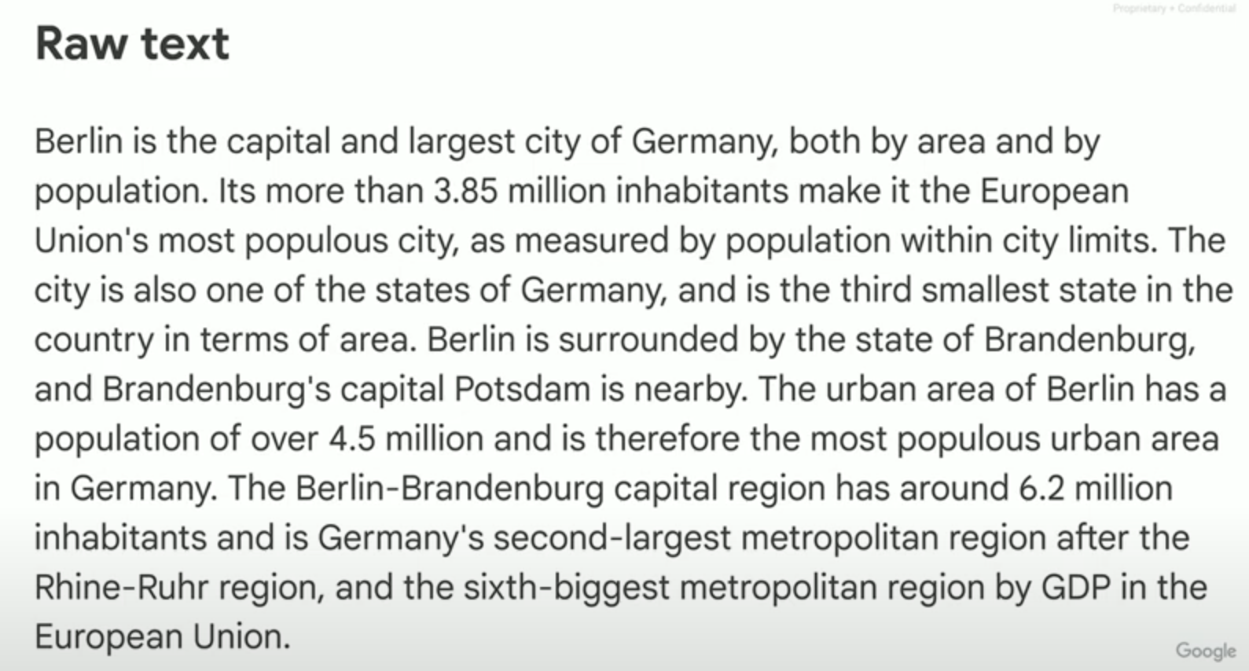
RAG: from dumb implementation to serious results by Guillaume Laforge https://bit.ly/3ZHhcPK

Slide 16
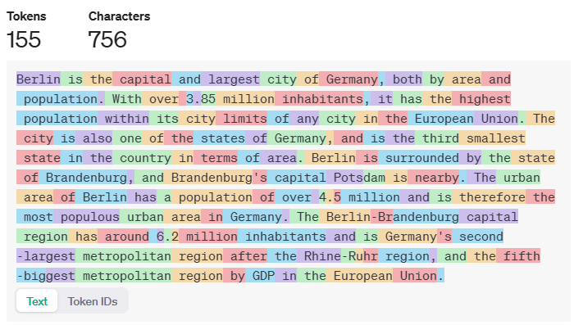
https://en.wikipedia.org/wiki/Berlin
Notes:
https://en.wikipedia.org/wiki/Berlin

Slide 17
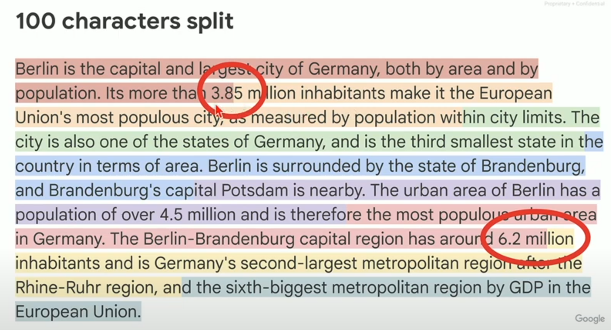
RAG: from dumb implementation to serious results by Guillaume Laforge https://bit.ly/3ZHhcPK

Slide 18
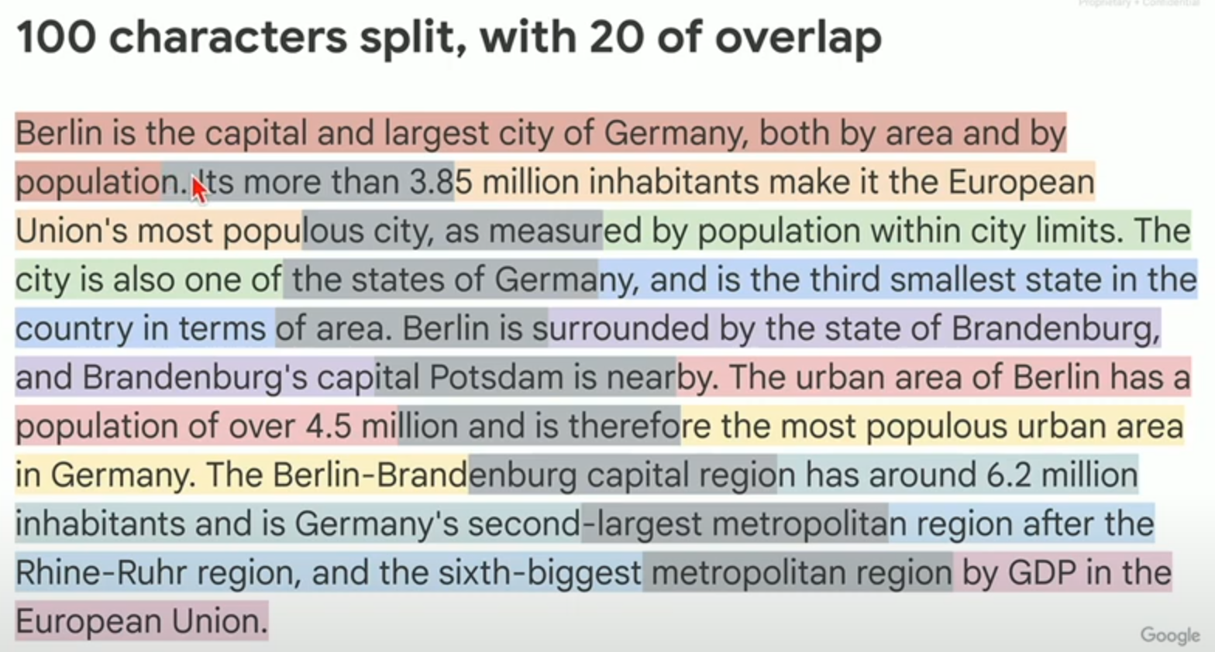
RAG: from dumb implementation to serious results by Guillaume Laforge https://bit.ly/3ZHhcPK

Slide 19
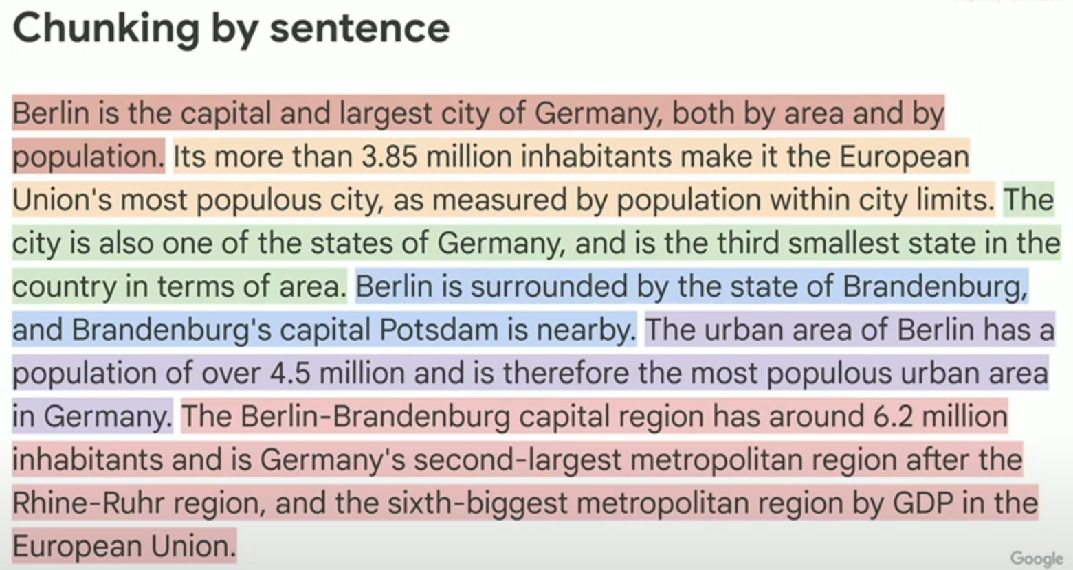
RAG: from dumb implementation to serious results by Guillaume Laforge https://bit.ly/3ZHhcPK

Slide 20
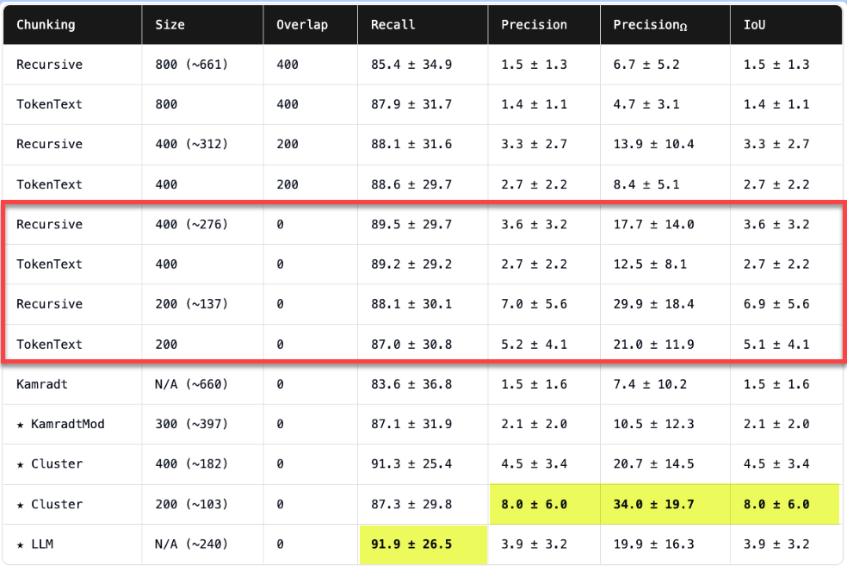
https://research.trychroma.com/evaluating-chunking
Notes:
Precision: It measures the accuracy of the search results by looking at how many of the retrieved documents are actually relevant.
Recall: It measures how well the search engine retrieves all the relevant documents available in the dataset.
Intersection over Union (IoU) is a metric used to evaluate the accuracy of object detection and segmentation models, but it can also apply to search relevance in some contexts.
https://research.trychroma.com/evaluating-chunking
https://research.trychroma.com/evaluating-chunking#chunking-algorithms – 5 different chunking strategies

Slide 21
Challenges – not all questions are easy
Type | Description
Yes/No | Answer is Yes or No | Has Lady Gaga ever made a song with Ariana Grande?
Comparative | Compare 2 objects on an attribute | Is Mont Blanc taller than Mount Rainier?
Generic | Simple question | Where was Michael Phelps born?
Intersection | Must fulfill 2 or more conditions | Which movie was directed by Denis Villeneuve and stars Timothee Chalamet?
Ordinal | Based on item in ordered list | Who was the last Ptolemaic ruler of Egypt?
Count | Answer required counting | How many astronauts have been elected to Congress?
Difference | Question with a negation | Which Mario Kart game did Yoshi not appear in?
Superlative | Max/Min of an attribute | Who was the youngest tribute in the Hunger Games?
Multi-hop | Requires 2 or more steps to answer | Who was the quarterback of the team that won Super Bowl 50?
https://github.com/amazon-science/mintaka

Slide 22
Resources
5 Levels Of Text Splitting
https://github.com/FullStackRetrieval-com/RetrievalTutorials/blob/main/tutorials/LevelsOfTextSplitting/5_Levels_Of_Text_Splitting.ipynb
Chunking - Optimizing Vector Database Data Preparation
https://research.trychroma.com/evaluating-chunking
The BEST Way to Chunk Text for RAG
https://www.youtube.com/watch?v=Pk2BeaGbcTE&t=2s

Slide 23
Lab 4: RAG with PDF Lab 5: Combine Web and PDF

Slide 24
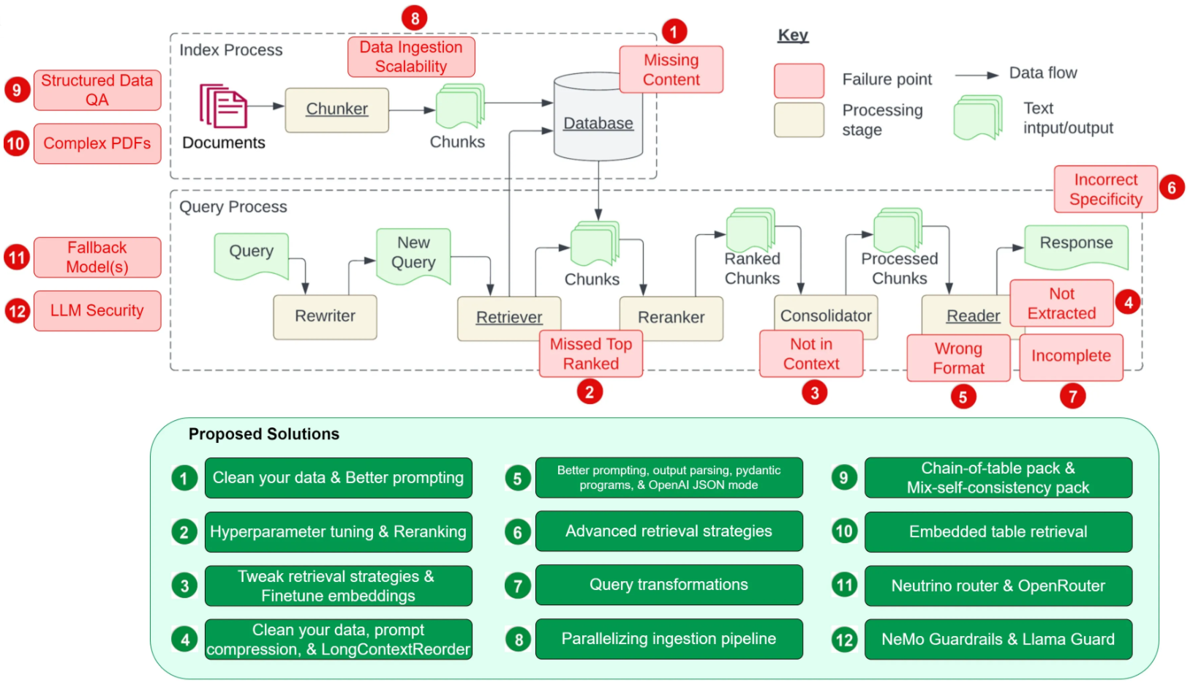
12 RAG Pain Points and Proposed Solutions, Wenqi Glantz https://bit.ly/3CRASHG

